Slide 1
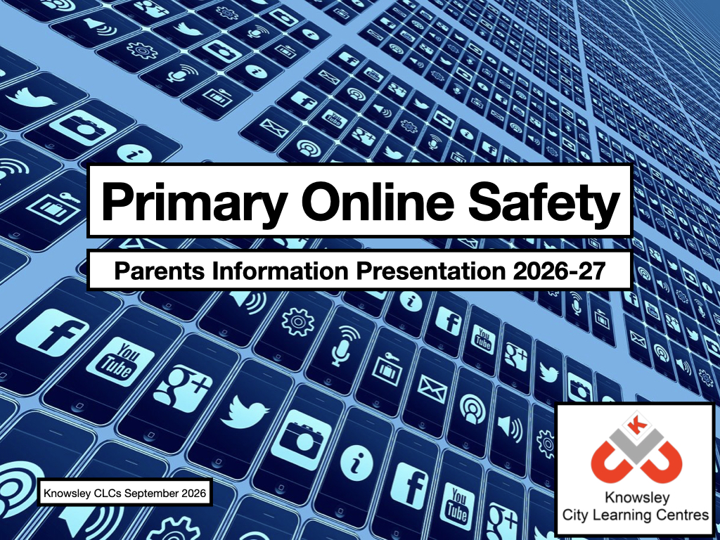

Slide 2
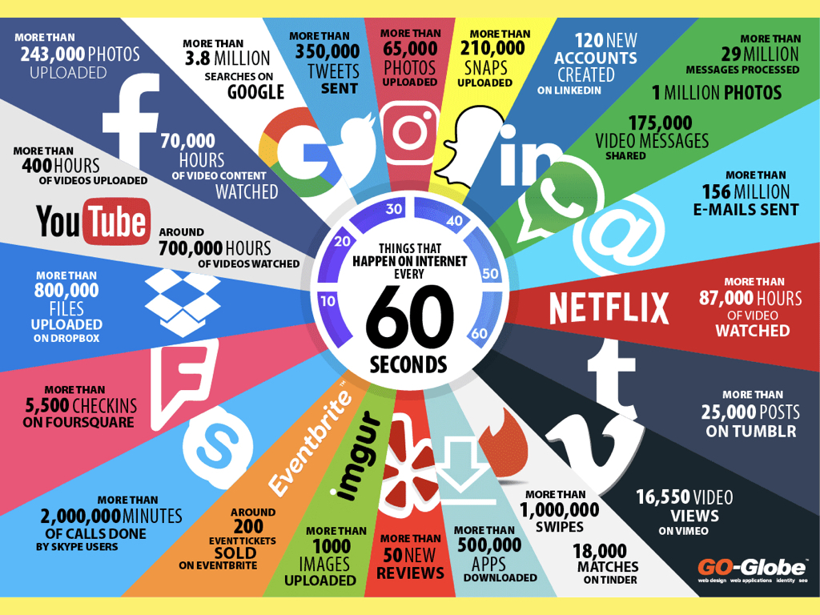

Slide 3
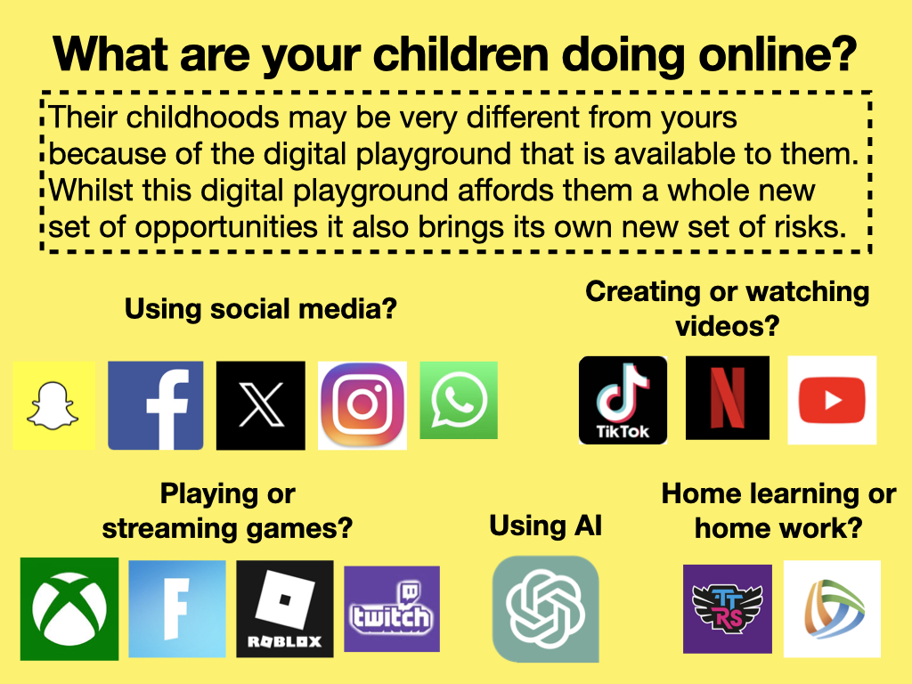

Slide 4
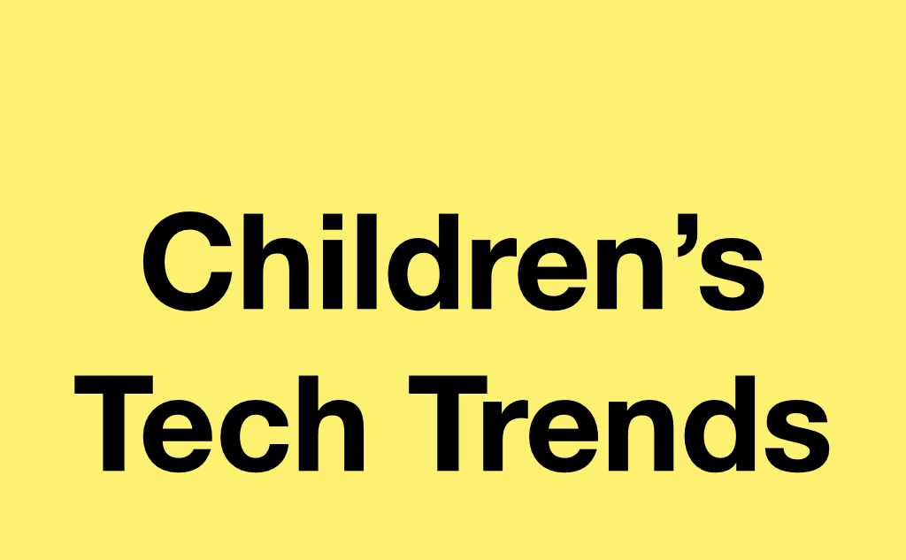
Ofcom children’s media use and attitudes report
https://www.ofcom.org.uk/siteassets/resources/documents/research-and-data/media-literacy-research/children/2026-children-and-parents-report/children-and-parents-media-use-and-attitudes-report-2025-6.pdf?v=418231
Internet Matters: wellbeing in a digital world 2025
https://www.internetmatters.org/hub/research/childrens-wellbeing-in-a-digital-world-index-report-2026/

Slide 5
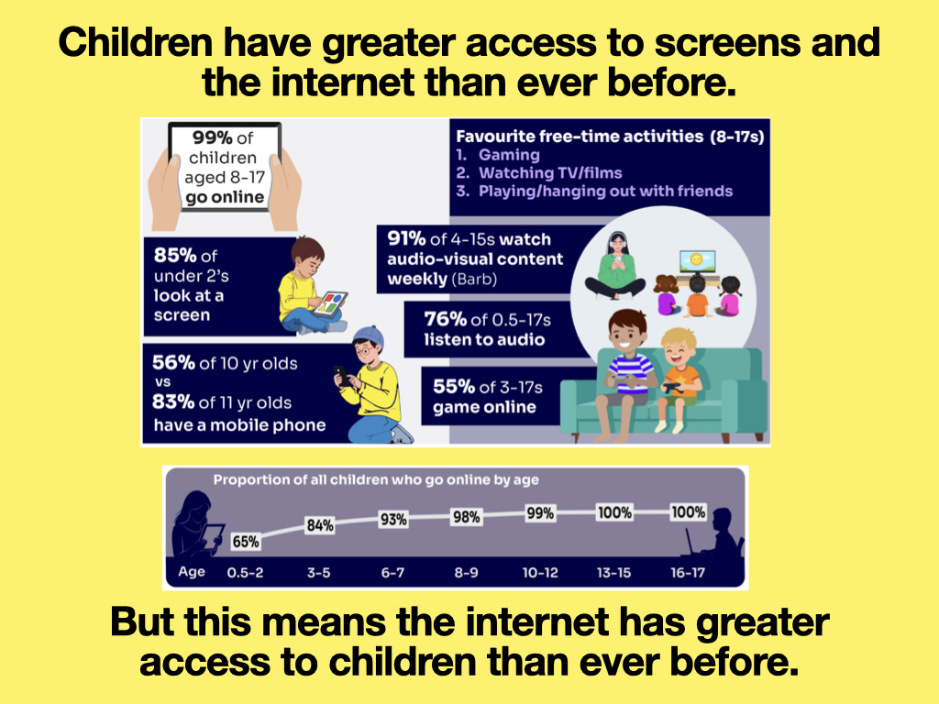

Slide 6
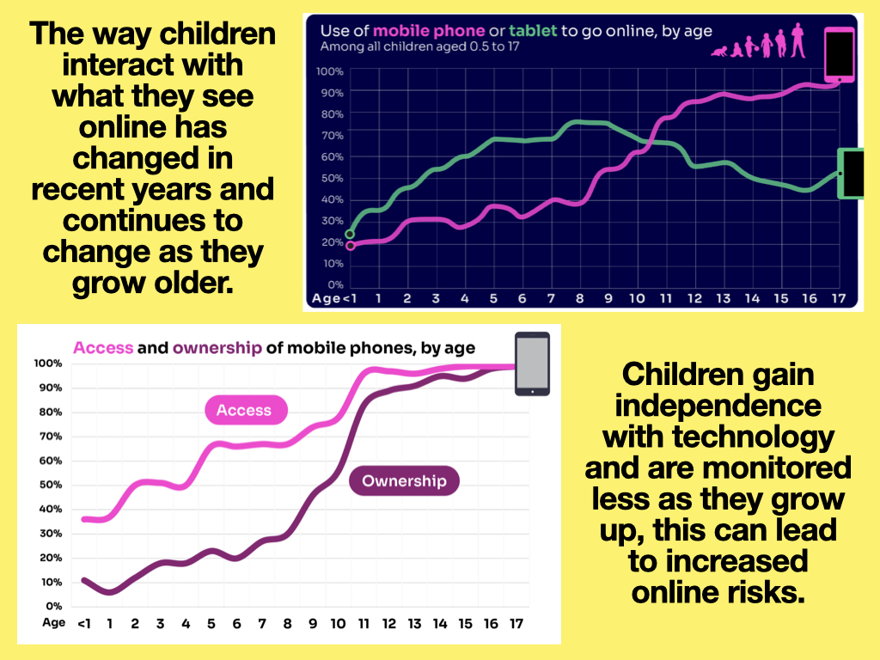

Slide 7
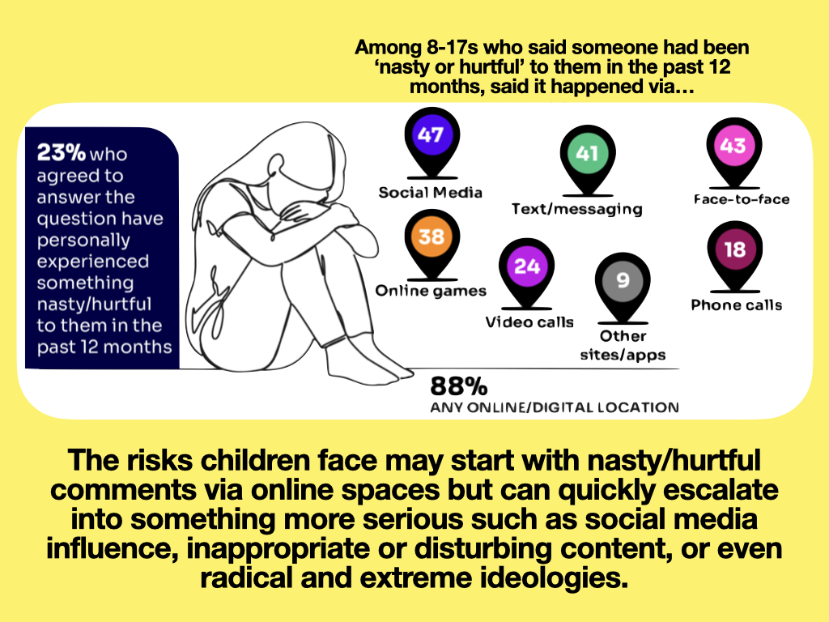

Slide 8
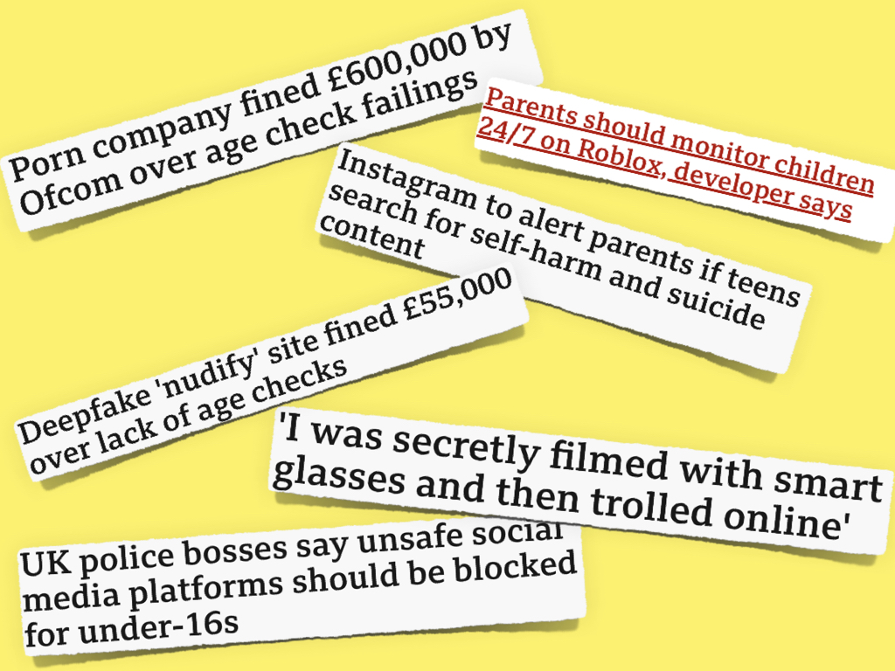

Slide 9
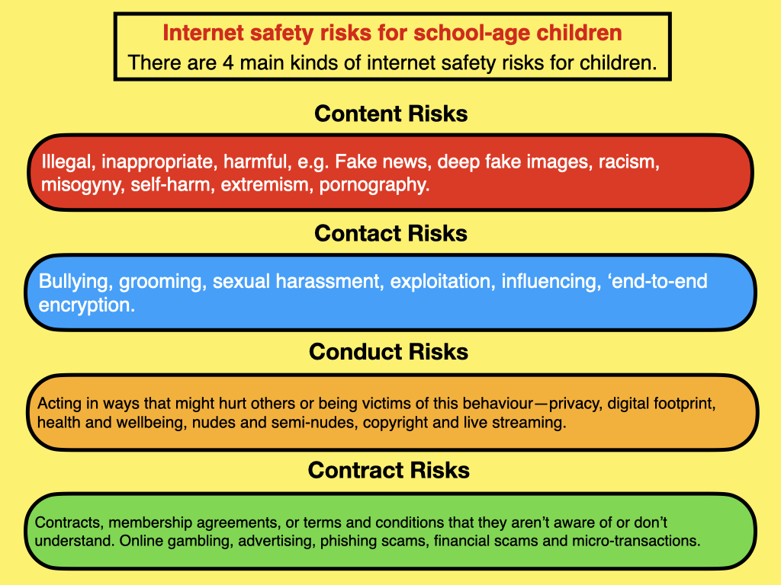
Yes

Slide 10
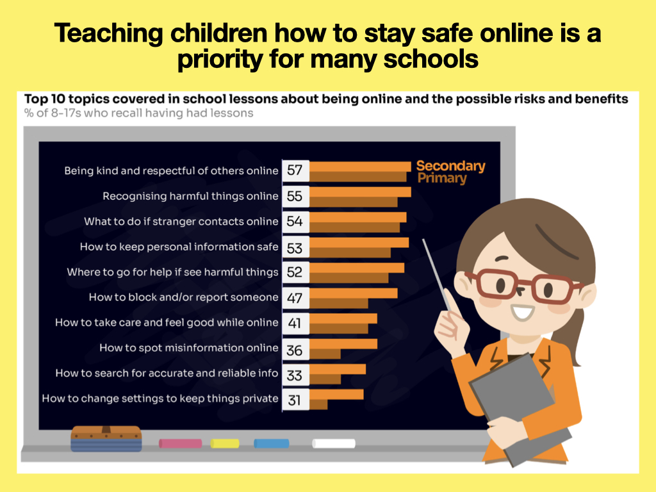

Slide 11
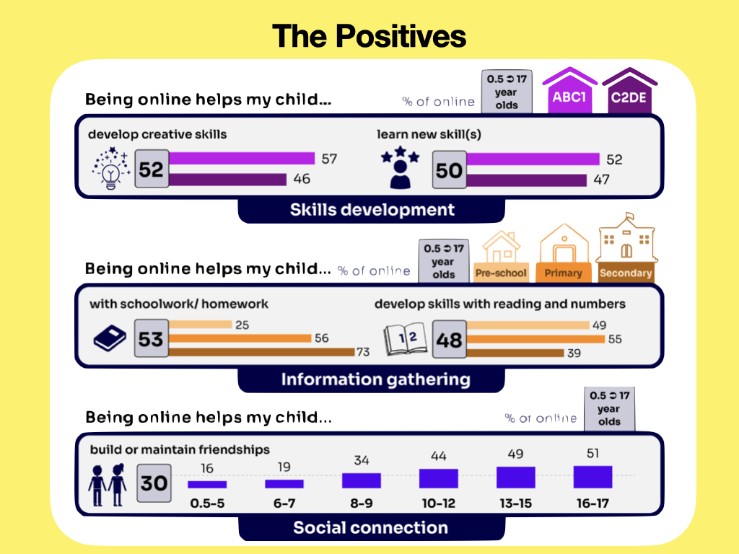

Slide 12


Slide 13
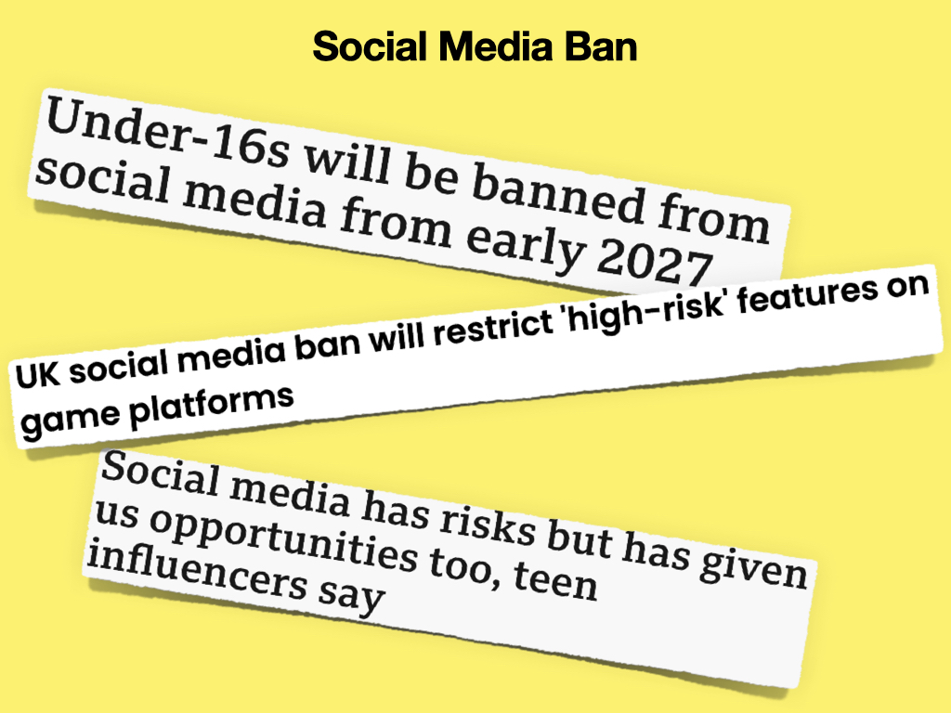

Slide 14


Slide 15


Slide 16
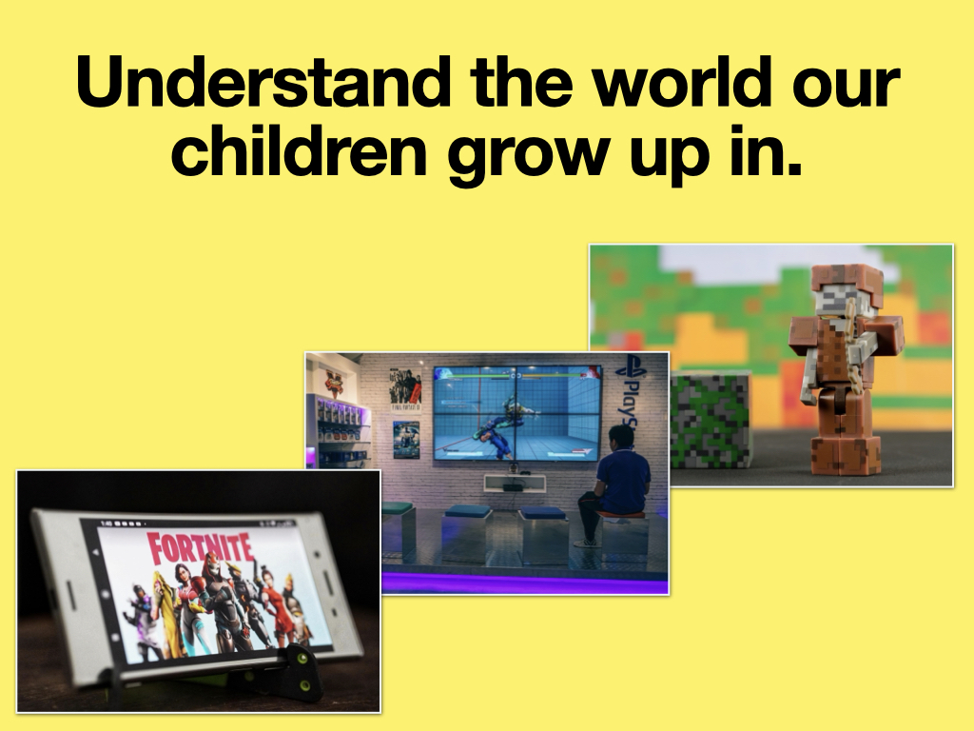

Slide 17
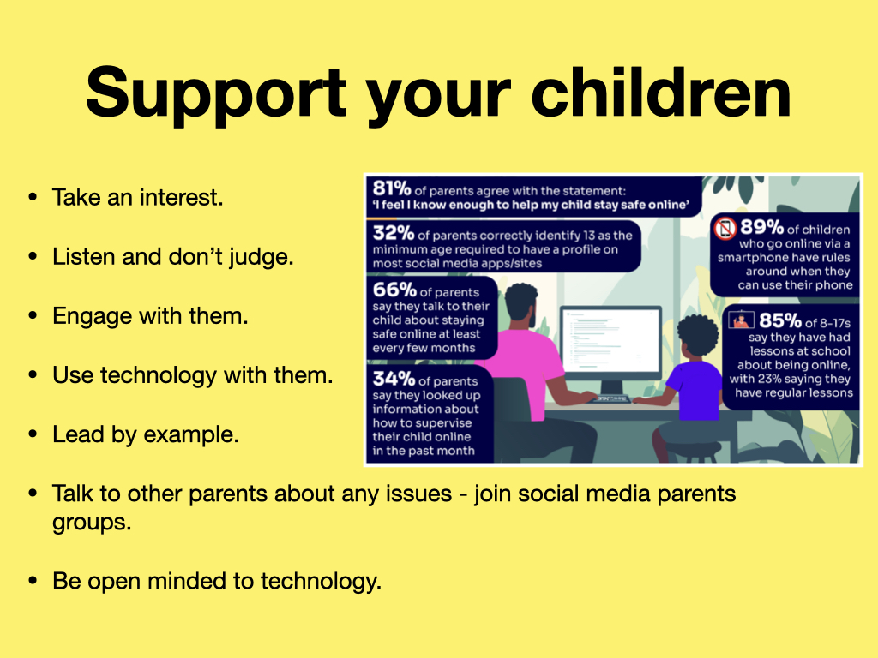

Slide 18
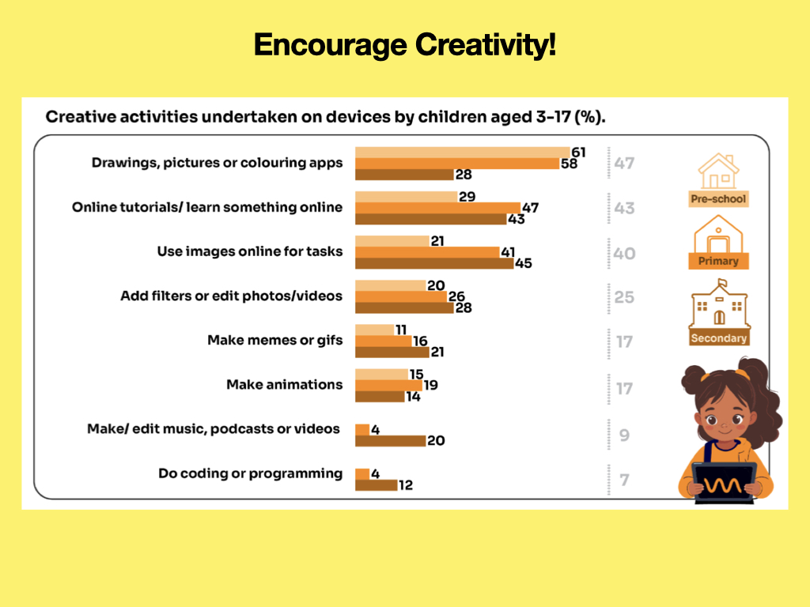

Slide 19
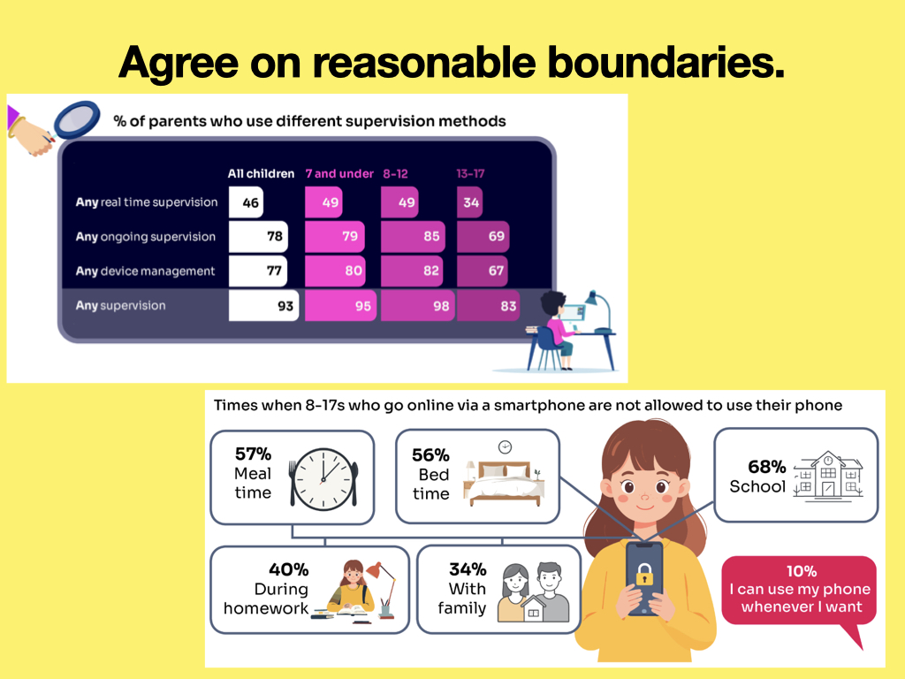

Slide 20
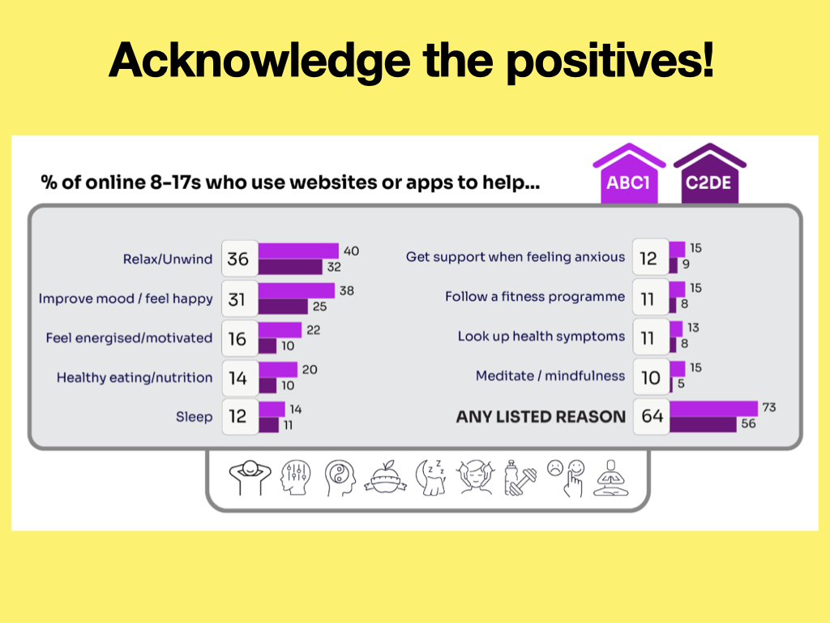

Slide 21
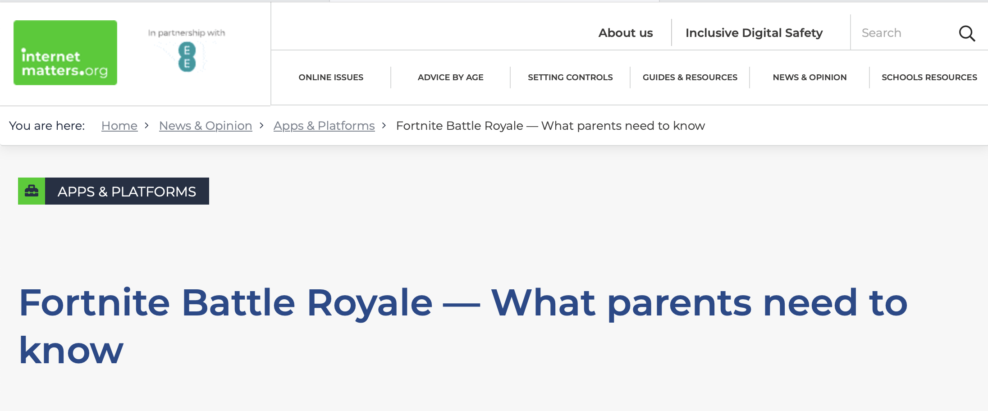

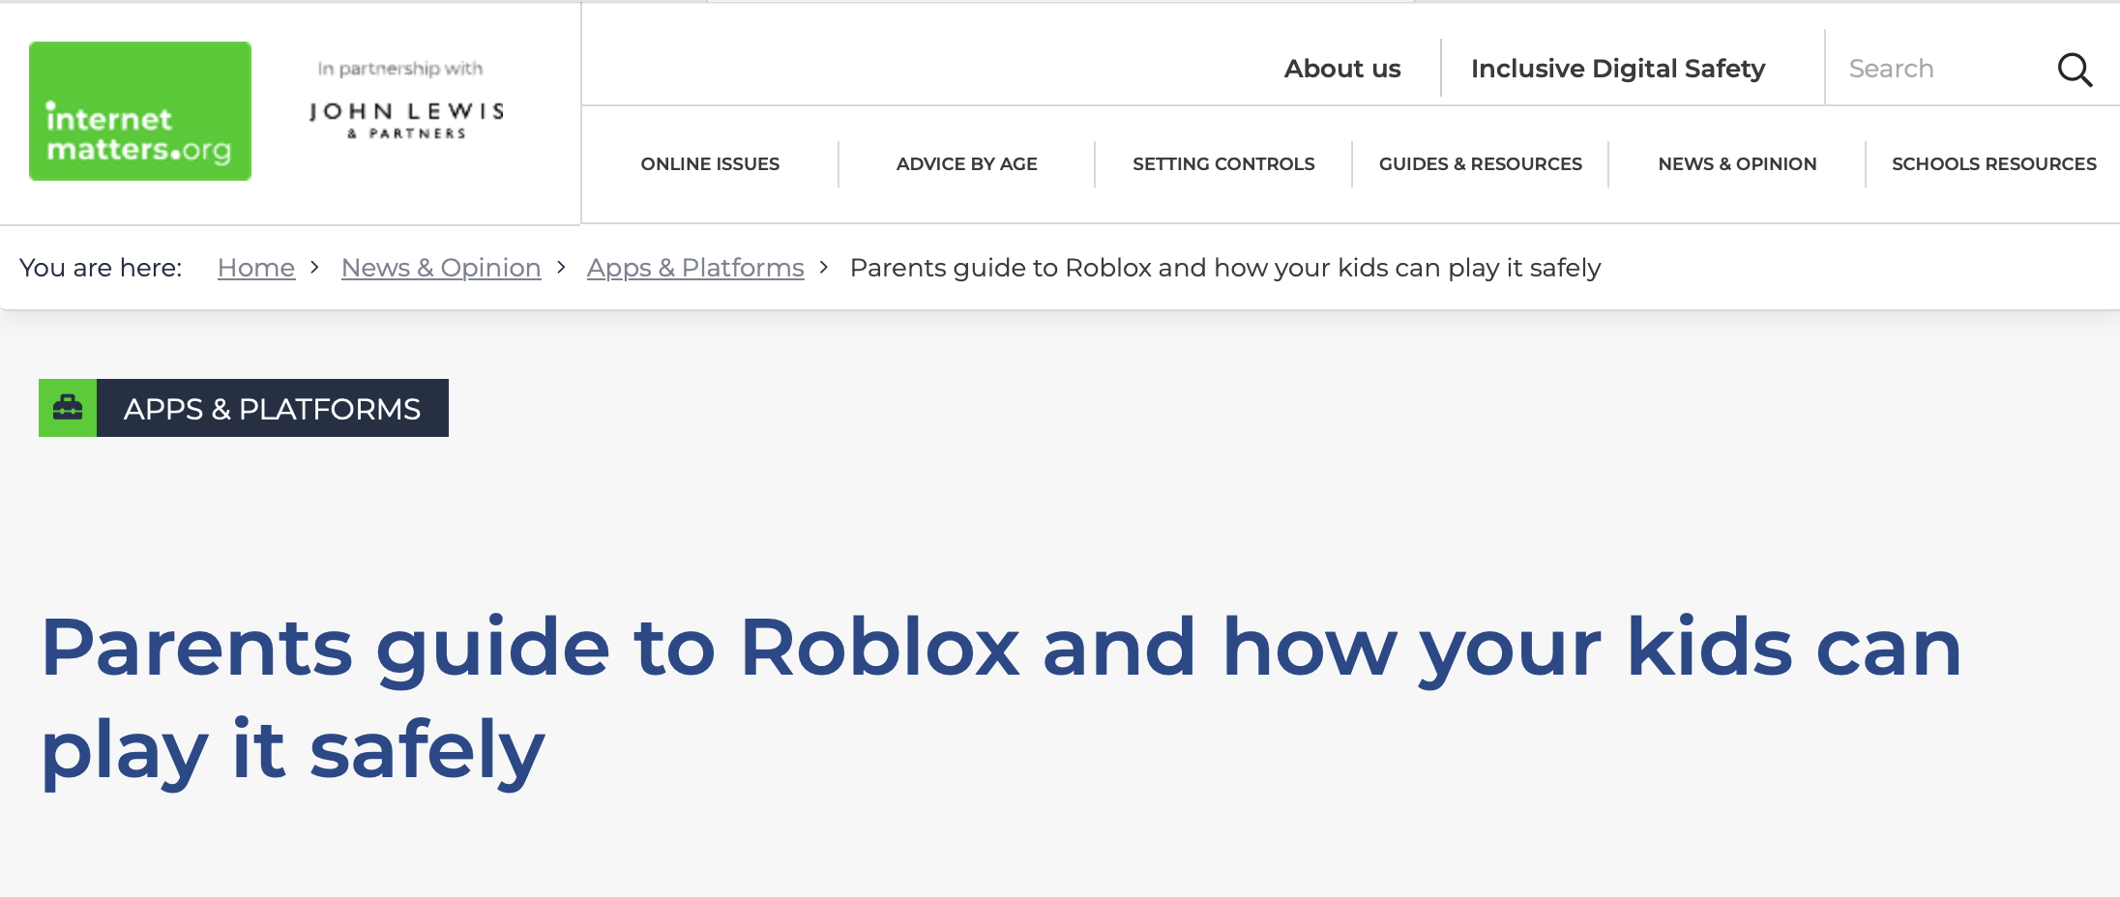
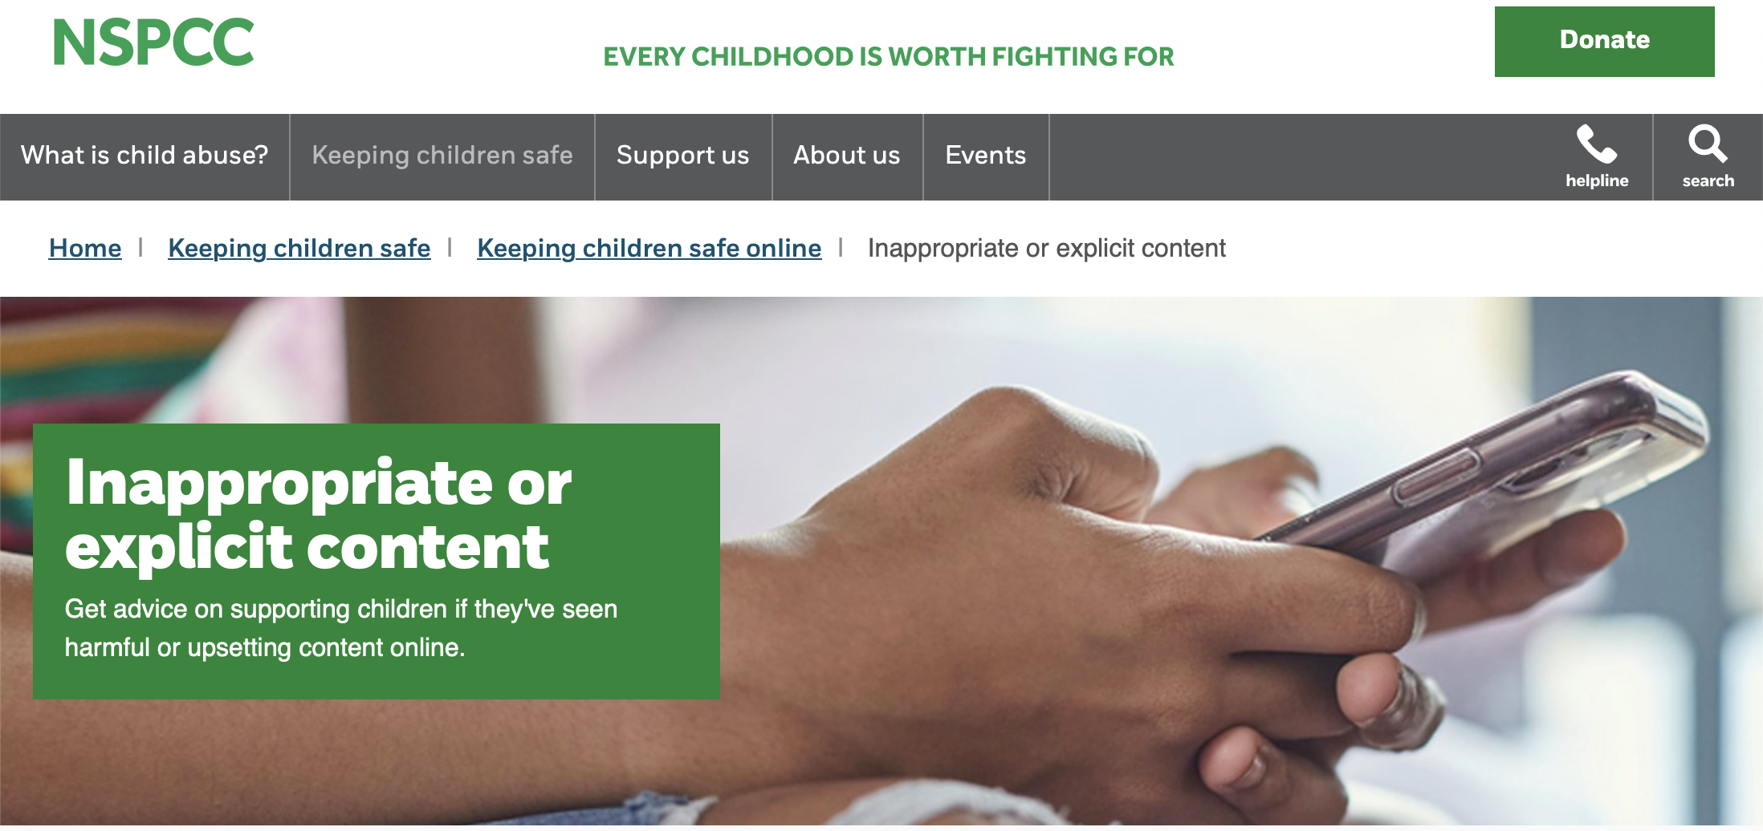
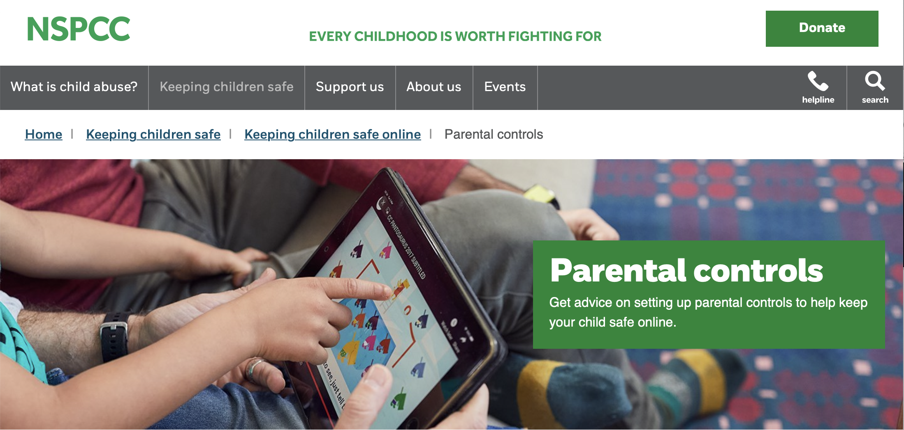

Be Knowledgeable
https://www.internetmatters.org/
https://www.nspcc.org.uk/keeping-children-safe/online-safety

Slide 22
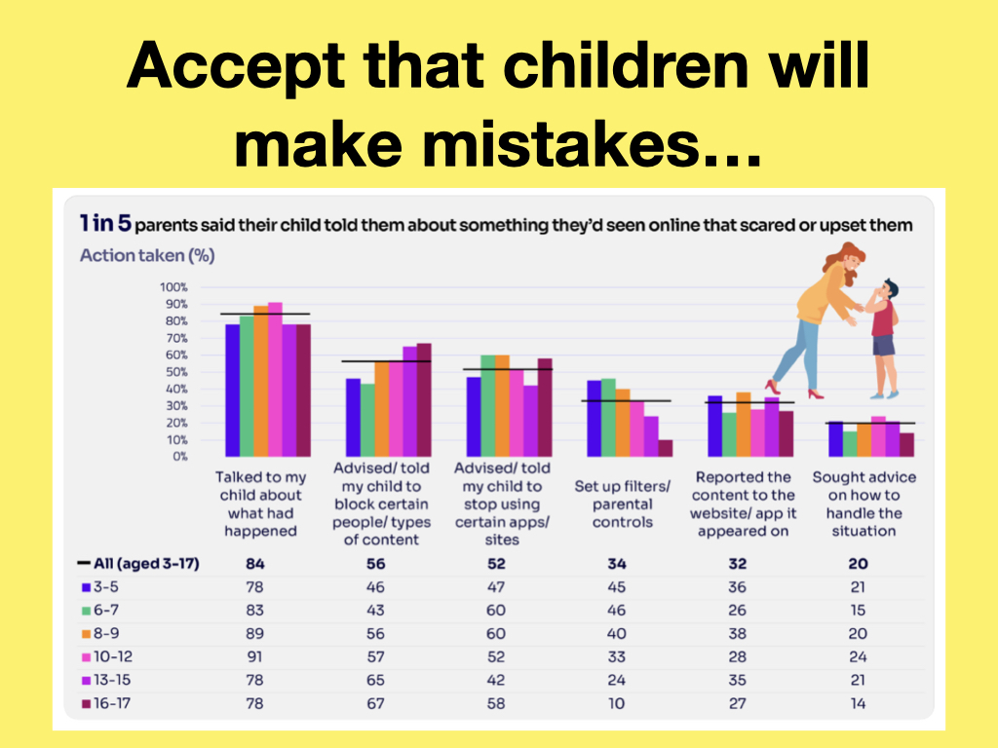

Slide 23
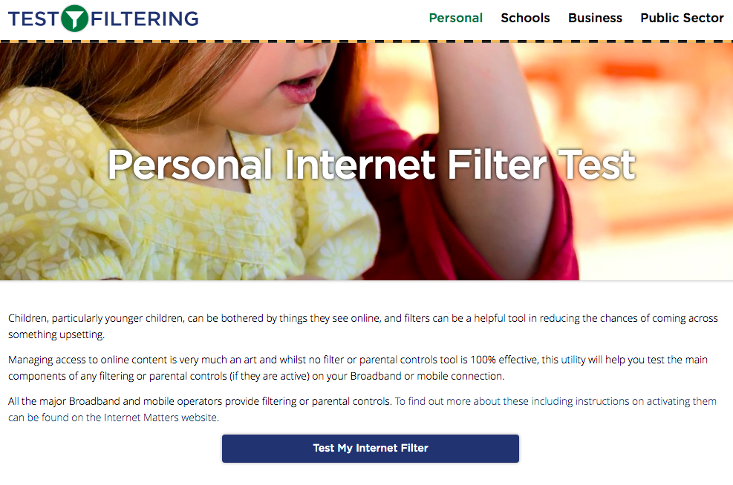
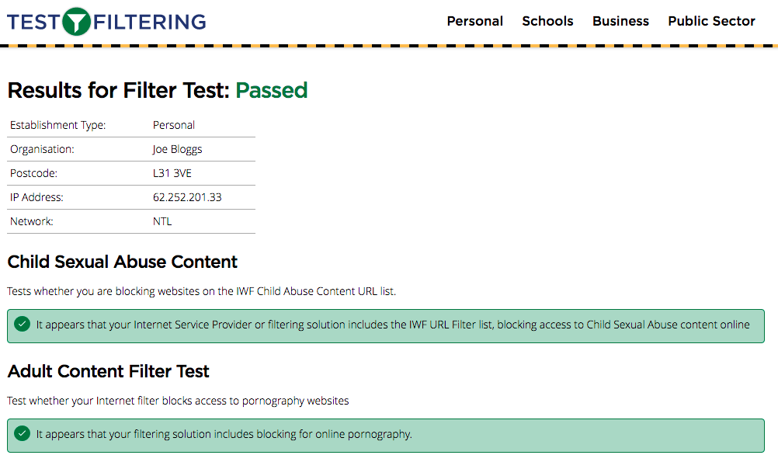
Test your home filtering
http://testfiltering.com/

Slide 24


Slide 25
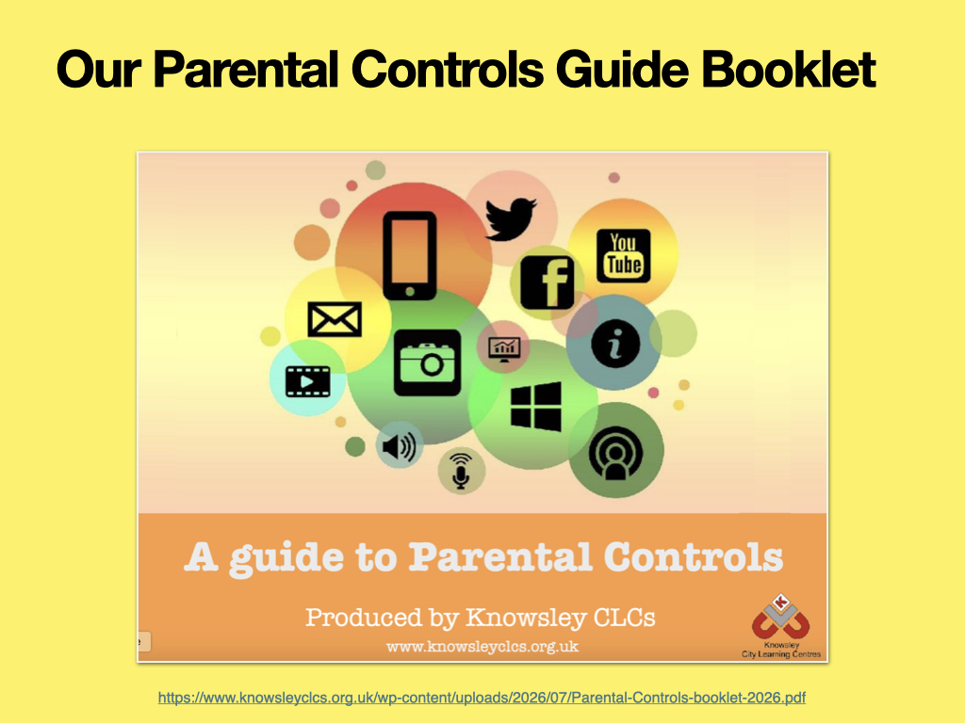
https://www.knowsleyclcs.org.uk/wp-content/uploads/2026/07/Parental-Controls-booklet-2026.pdf

Slide 26
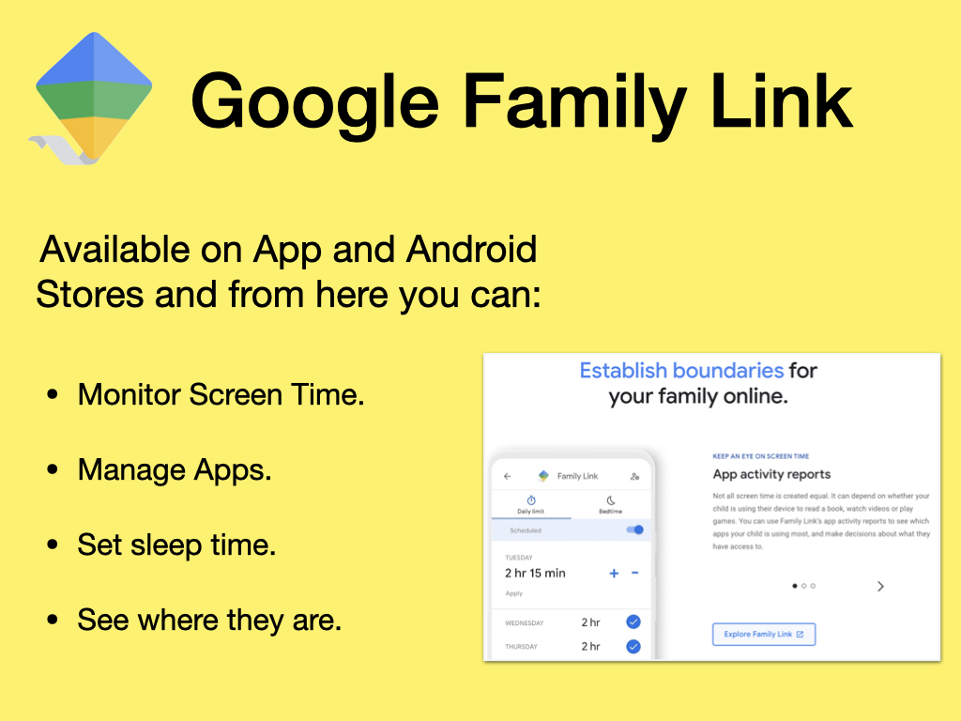

Slide 27
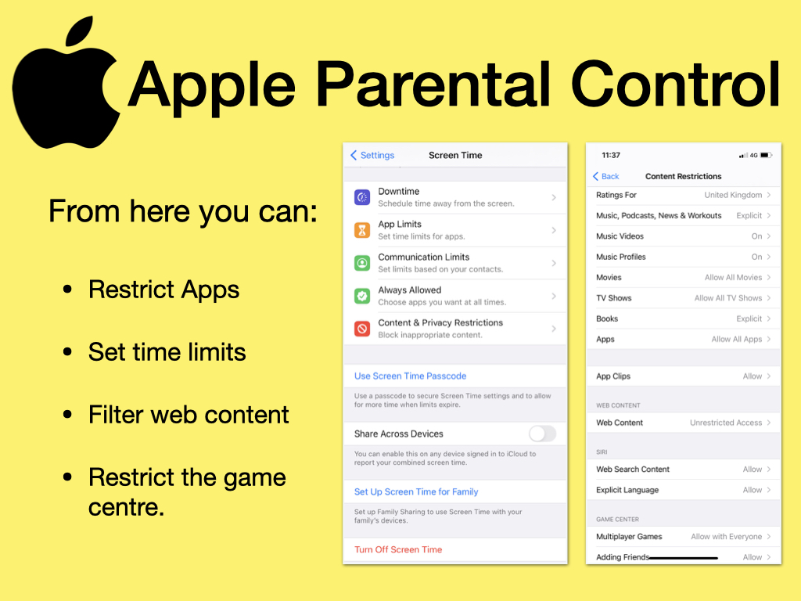

Slide 28
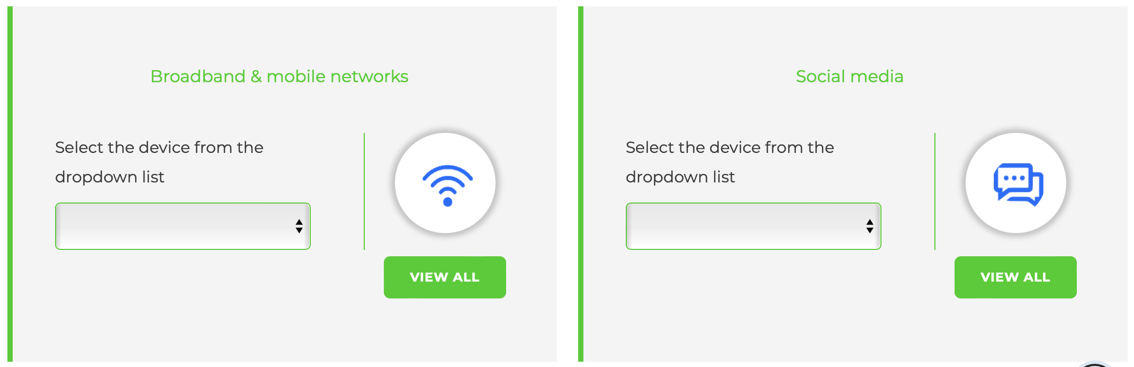
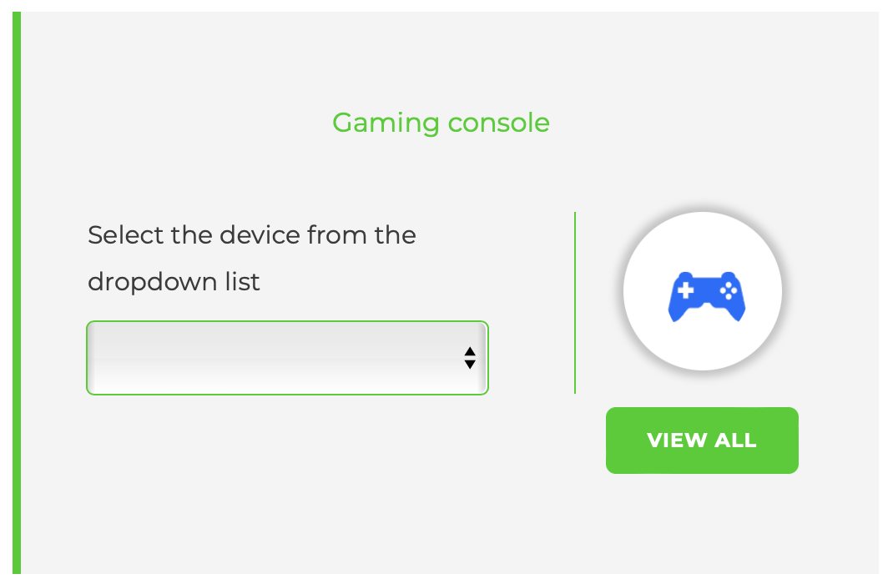
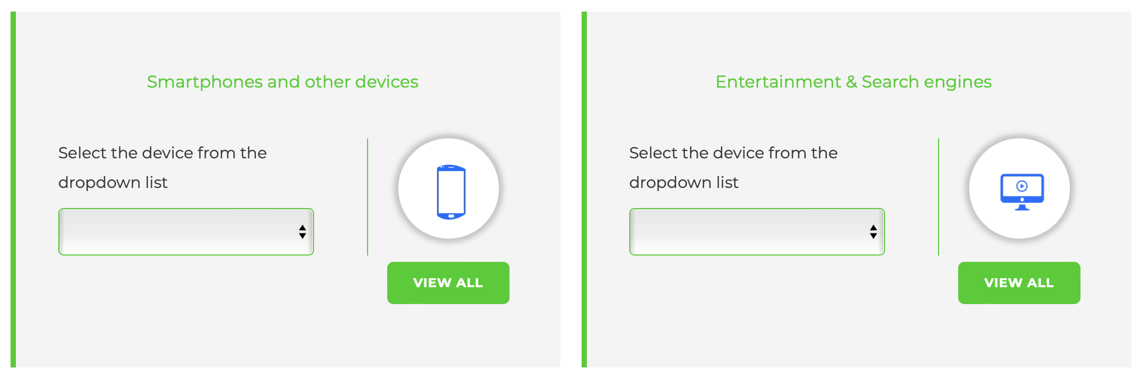
Internet matters also contains parental control guides for dozens of other devices including games consoles and smartphones
https://www.internetmatters.org/parental-controls

Slide 29


